Slide 1



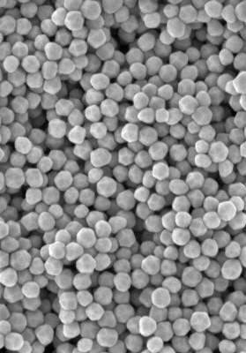


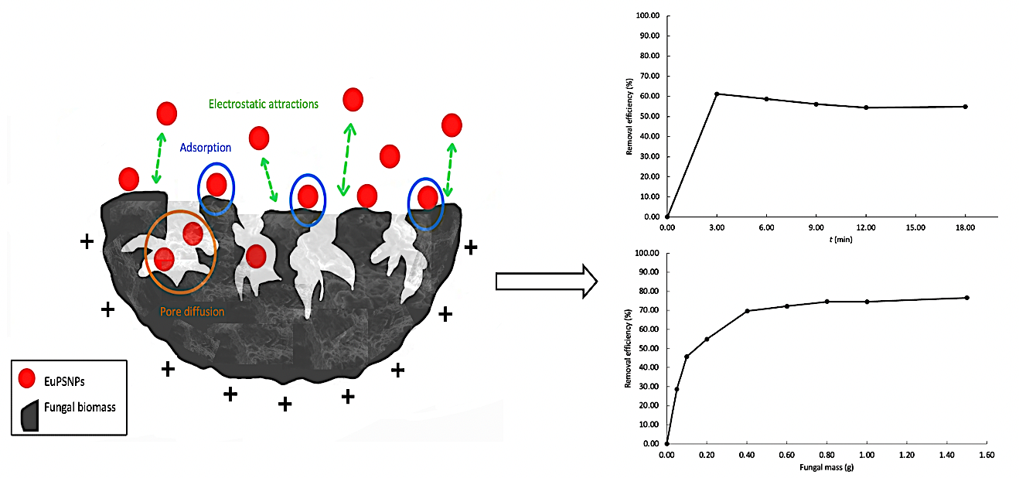


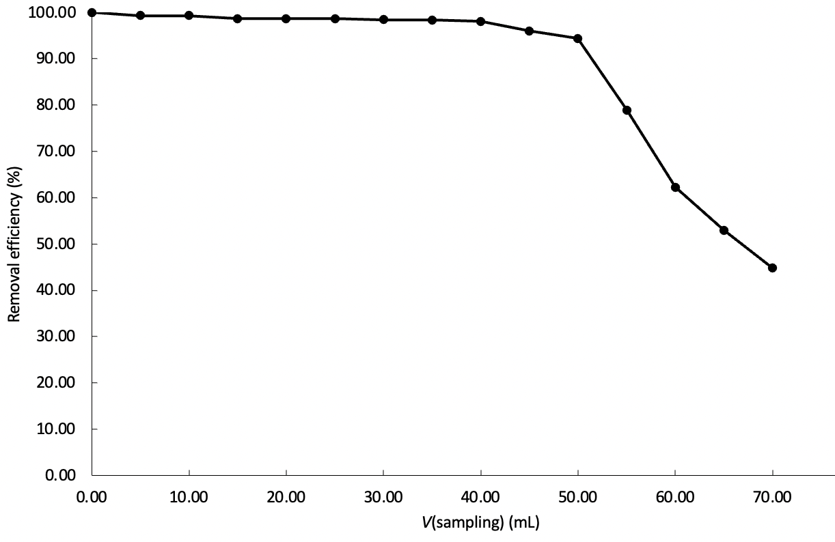
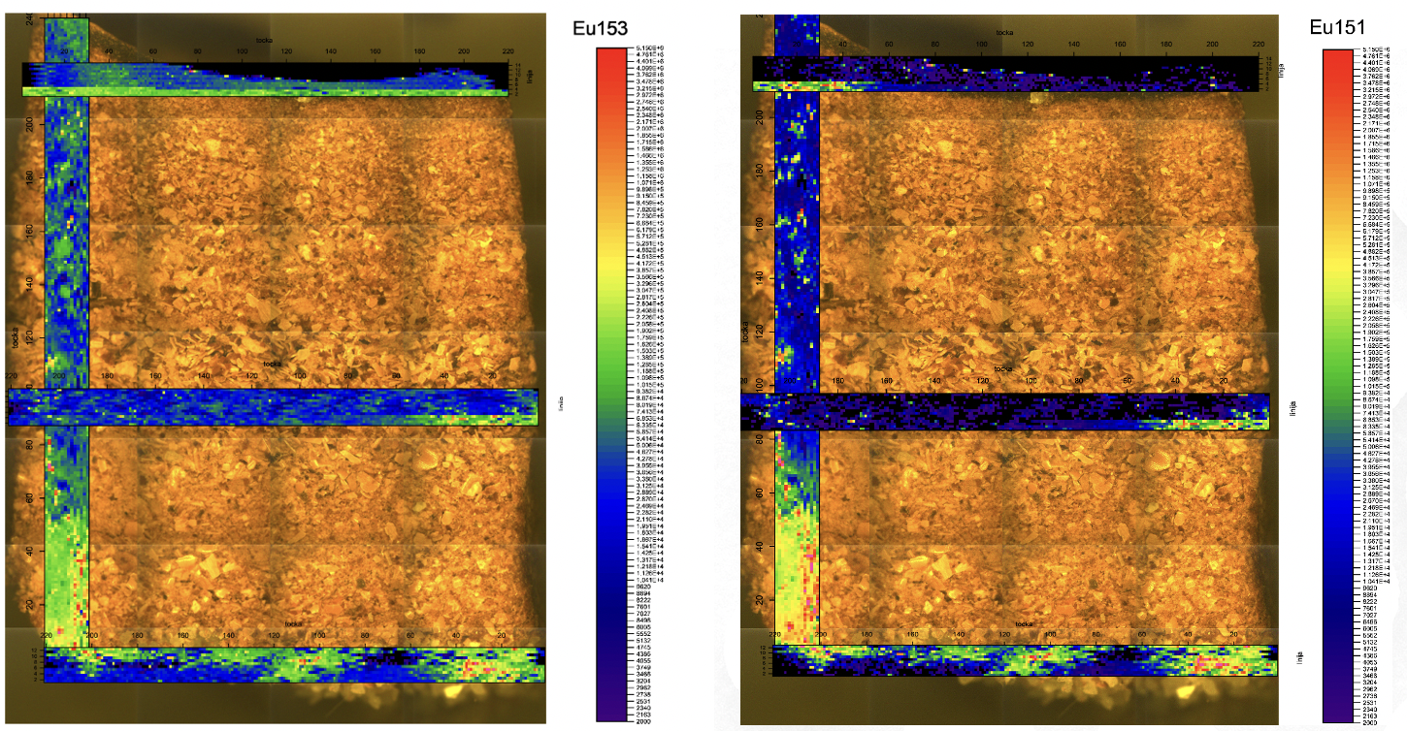
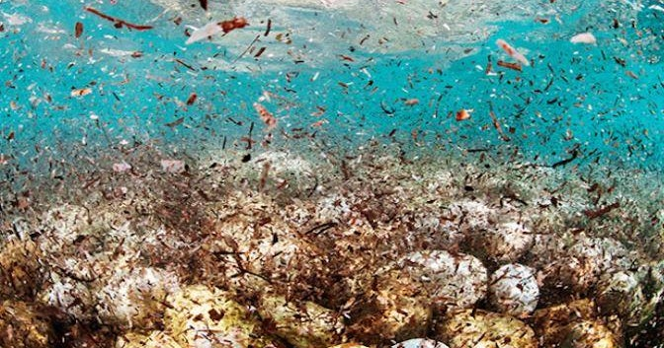

Tracing nanoplastics removal dynamics: Europium-labeled polystyrene adsorption on fungal biomass in a simulated treatment system
Tia Kralj*,¹ Miha Lukšič,¹ Andrej Gregori,^{2,3} Gregor Marolt¹
¹ Faculty of Chemistry and Chemical Technology, University of Ljubljana, Večna pot 113, SI-1000 Ljubljana, Slovenia ² Biotechnical Faculty, University of Ljubljana, Jamnikarjeva 101, SI-1000 Ljubljana, Slovenia
³ MycoMedica Ltd, Podkoren 72, SI-4280 Kranjska Gora, Slovenia
Nanoplastics in environment
Nanoplastics (NPs) are an emerging global concern due to their persistence, mobility, and harmful effects on ecosystems and human health. NPs (<100 nm) are especially problematic because of their high surface area, colloidal stability, and ability to cross biological barriers, causing oxidative stress, inflammation, and genotoxicity. They also adsorb pollutants such as heavy metals and POPs, amplifying their toxicity. Conventional water treatment often fails to remove nanoscale plastics, while adsorption offers a promising alternative. However, traditional adsorbents face cost and reusability challenges. Fungal biomass has emerged as a sustainable solution, with functional groups on fungal cell walls enabling effective NP binding [1,2,3].
Batch adsorption system
The adsorption performance of TRVE biomass was evaluated under different conditions. Removal efficiency of europium-doped polystyrene nanoplastics (EuPSNPs) (0.5 g TRVE; 1400 µg/L EuPSNPs) increased rapidly within the first 3 minutes of contact, reaching about 62%, and then stabilized, indicating fast occupation of active sites followed by equilibrium. Biomass dosage also influenced adsorption: increasing mass from 50 to 400 mg enhanced removal efficiency (77%), while higher amounts produced little further improvement, reflecting saturation of available adsorption sites.
A
B
Detection of nanoplastics
Eu concentrations in the effluent were quantified using ICP-OES to assess adsorption efficiency. Furthermore, LA-ICP-MS was employed to resolve the presence and distribution EuPSNPs within the biomass-packed column.
Fig. 1 Dependence of the batch system PSNPs removal efficiency on: A) time of adsorption ; B) added mass of fungal material (0.05 – 1.5 g) in 50 mL of MQ water at stirring speed of 1000 rpm.
Column adsorption system
A fixed-bed column packed with 0.7 g of T. versicolor biomass (TRVE) (influent: 1400 µg/L EuPSNPs) showed >95% removal within the first 45 mL of effluent, followed by a gradual decline to ~55% at 70 mL (Fig. 2C). LA-ICP-MS elemental mapping of 153Eu and 151Eu confirmed the presence and distribution of europium within the biomass-packed column (Fig. 2D), with intensity increasing toward the lower layers of the column, indicating nanoparticle migration and accumulation during flow-through. Both isotopes showed consistent spatial patterns, with 153Eu exhibiting slightly stronger signals due to its higher natural abundance.
C
D
Fig. 2 C) Dependence of the EuPSNPs removal efficiency in a fixed-bed column system on volume of effluent using 0.7 g of fungal biomass at flow rate 1.0 mL min⁻¹ of 1400 μg L^{–1} EuPSNPs in MQ; D) LA-ICP-MS image using 0.7 g of fungal biomass with 65 μm circle spot size, 100 μm/s scan speed, 100 Hz repetition rate, 3.0 J/cm² fluence and 11.0 x 1.0 mm² in dimentions.
E
F
Fig. 3 E) Dependence of PSNPs removal efficiency on the adsorption time in batch system, performed with 0.5 g of fungal biomass and the initial PSNPs concentration of 0.7 mg L⁻¹ and 1.4 mg L⁻¹ and stirring speed 1000 rpm; F) Evaluation of biosorption isotherms for PSNPs removal in a batch system.
Adsorption kinetics & isotherms
Kinetic analysis of PSNP biosorption by TRVE showed a rapid initial uptake that reached equilibrium and fit well to a pseudo-first-order model, indicating a physisorption-driven process (Fig. 3E). Equilibrium adsorption isotherms (Fig. 3F) were described by the Langmuir–Freundlich model, revealing heterogeneous binding sites and strong TRVE affinity for PSNPs.
Results & Conclusion
T. versicolor biomass proved to be a low-cost, renewable biosorbent for polystyrene nanoplastics (PSNPs), achieving high removal in both batch and column setups. Optimized columns reached near-complete adsorption, with LA-ICP-MS confirming uniform particle distribution. Adsorption followed pseudo-first-order kinetics and fit the Langmuir–Freundlich isotherm, indicating physisorption on heterogeneous sites. Together, biosorption and sensing offer an effective, sustainable strategy for nanoplastic removal and monitoring, advancing integrated solutions for water quality protection.
Fig. 4 Nanoplastics pollution in ocean.
References
[1] Tripathi, M., et al. Journal of Xenobiotics, 2025, 15(1), 30.
[2] Baldrian, P. (2003), Enzyme and Microbial technology, 32(1), 78-91.
[3] Novak, S., et al. Ecotoxicology and Environmental Safety, 2025, 301, 118491.

Slide 2
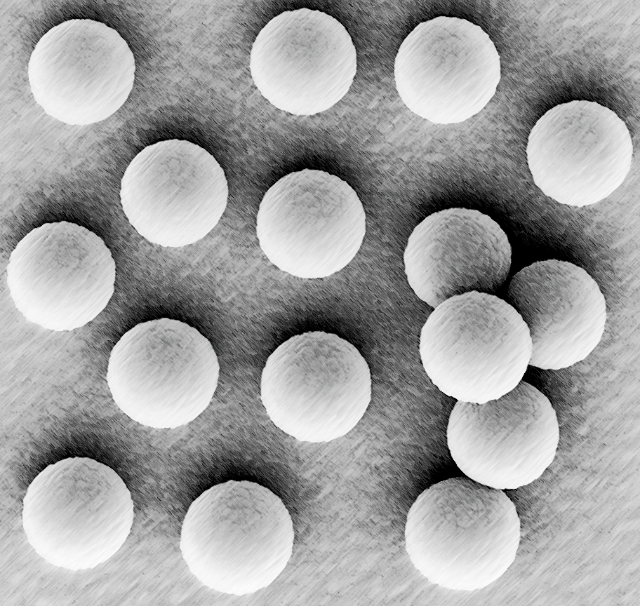

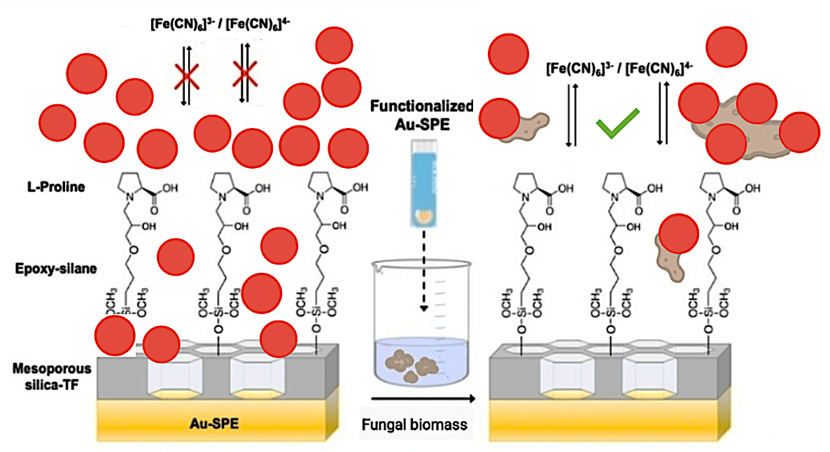
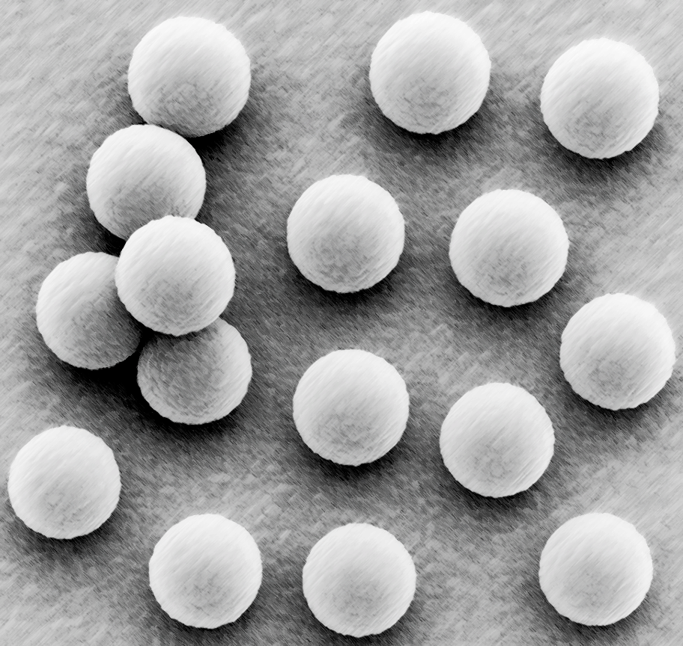
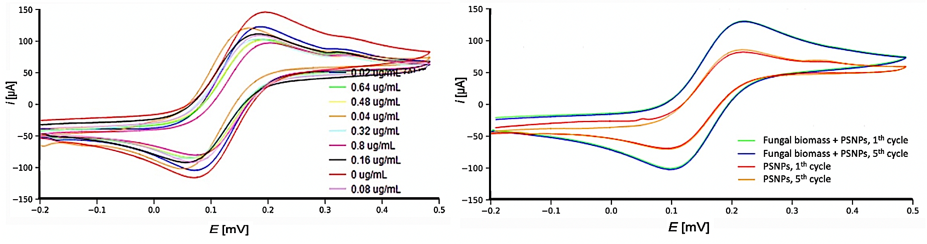

Electrochemical Monitoring of Polystyrene Nanoplastics – Fungal Biomass Interactions for Advanced Sensing Applications
Tia Kralj*,¹ Andrej Gregori,^{2,3} Gregor Marolt,¹
¹ Faculty of Chemistry and Chemical Technology, University of Ljubljana, Večna pot 113, SI-1000 Ljubljana, Slovenia ² Biotechnical Faculty, University of Ljubljana, Jamnikarjeva 101, SI-1000 Ljubljana, Slovenia
³ MycoMedica Ltd, Podkoren 72, SI-4280 Kranjska Gora, Slovenia
Nanoplastics in environment
Nanoplastics (NPs) are emerging pollutants of concern due to their persistence, mobility, and ability to penetrate biological systems, posing risks to aquatic ecosystems and human health. Their small size and complex interactions in water make detection challenging, often requiring advanced instrumentation. In this work, we present a novel approach combining the removal of polystyrene nanoplastics (PSNPs) using Trametes versicolor (TRVE) biomass with electrochemical monitoring to evaluate adsorption in real time under different operational conditions.
Sensor preparation
The sensor is based on Au screen-printed electrode (SPE) modified with mesoporous silica thin film by electro-assisted deposition, followed by functionalization with epoxy-silane and L-Proline [3,4]. Detection relies on PSNP binding to amino groups and electrostatic attraction under positive potential. The optimal accumulation potential was +0.6 V, determined in 5 mM HCF by cyclic voltammetry (CV).
Fig. 1 PSNPs detection via pore blocking on functionalized Au-SPE and their removal by fungal biomass, preserving the electrochemical signal.
Detection of nanoplastics
L-Proline captures PSNPs through binding to surface-immobilized amino groups and electrostatic attraction under positive potential. The adsorbed particles create a blocking layer over the electrode, limiting access of the [Fe(CN)₆]³⁻/[Fe(CN)₆]⁴⁻ probe to the active surface. When TRVE biomass was added, no pore blockade occurred, indicating nearly complete removal of PSNPs from the solution.
A
B
Fig. 2 A) CV for the 1th cycle during measurements with the addition of different concentrations of PSNPs; B) CV for the 1th and 5th cycle for measurements with and without the addition of fungal biomass in a solution containing PSNPs.
Results & Conclusion
A calibration curve for 6.1 nm PSNPs (0.02–0.8 µg/mL) showed a 15–35% decrease in i_{pa} observed by cyclic voltammogram (CV). Peak current decrease was proportional to PSNP concentration. Addition of 0.05 mg TRVE biomass to 0.8 µg/L PSNP suspension caused no i_{pa} decrease, indicating near-complete adsorption and removal. The sensor enabled real-time monitoring without biomass interference. This study demonstrates a portable electrochemical sensor for on-site detection of PSNPs and their sustainable removal from aquatic environments.
Fig. 3 Nanoplastics pollution in ocean.
References
[1] Sana, S. S.; Dogiparthi, L. K.; Gangadhar, L.; Chakravorty, A.; Abhishek, N. Effects of microplastics and nanoplastics on marine environment and human health. Environ. Sci. Pollut. Res. 2020, 27 (36), 44743–44756.
[2] Zhang, B.; Chao, J.; Chen, L.; Liu, L.; Yang, X.; Wang, Q. Research progress of nanoplastics in freshwater. Sci. of The Tot. Environ. 2021, 757, 143791.
[3] Walcarius, A. Electrochem. applic. of silica-based materials. Chem. Mater. 2001, 13 (10), 3351–3372
[4] Fernández, I.; Sánchez, A.; Díez, P.; Martínez-Ruiz, P.; Di Pierro, P.; Porta R.; Villalonga, R.; Pingarrón, J. M. Nanochannel-based electrochemical assay for transglutaminase activity. Chem. Communic. 2014, 50, 13356–13358.

